Slide 1
HOUSE PRICE PREDICTION USING BOSTON DATASET
BY - Vanka Janaki Rama Santhosh – B190044EC
Vivek – B190046EC

Slide 2
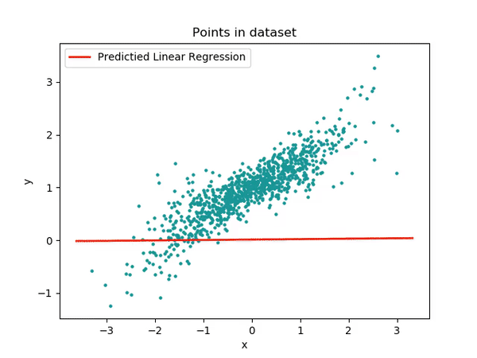

What is Linear Regression ?
Regression models are supervised learning models that are generally used when the value to be predicted is of discrete or quantitative nature. One of the most common example where regression models are used is predicting the price of a house by training the data of sale of houses of that region.The idea behind Linear Regression model is to obtain a line that best fits the data. By best fit, what is meant is that the total distance of all points from our regression line should be minimal. Often this distance of the points from our regression line is referred to as an Error though it is technically not one. We know that the straight line equation is of the form:
Here y is the Dependent Variable, x is the independent Variable, m is the Slope of the line and c is the Coefficient (or the y-intercept). Herein, y is regarded as the dependent variable as its value depends on the values of the independent variable and the other parameters.

Slide 3

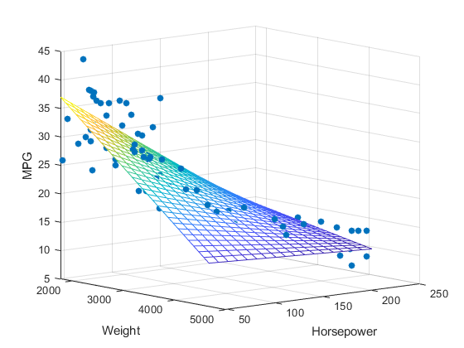
One common function that is often used in regression problems is the Mean Squared Error or MSE, which measure the difference between the known value and the predicted value.
RMSE tells us how close the data points are to the regression line.
Now we are building the regression model for predicting the house
Price. The output be like

Slide 4
Decision Tree Regression
Decision tree regression observes features of an object and trains a model in the structure of a tree to predict data in the future to produce meaningful continuous output. Continuous output means that the output/result is not discrete, i.e., it is not represented just by a discrete, known set of numbers or values.
Discrete output example: A weather prediction model that predicts whether or not there’ll be rain on a particular day.
Continuous output example: A profit prediction model that states the probable profit that can be generated from the sale of a product.
We can see that if the maximum depth of the tree (controlled by the max_depth parameter) is set too high, the decision trees learn too fine details of the training data and learn from the noise, i.e. they overfit.

Slide 5
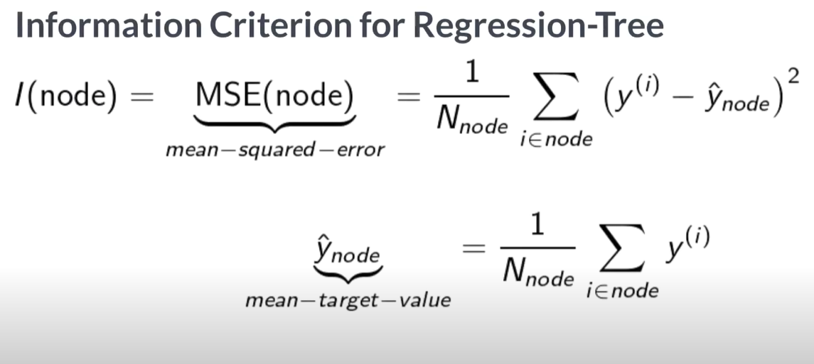
INFORMATION CRITERION
The decision of making strategic splits heavily affects a tree’s accuracy. The decision criteria is different for classification and regression trees.Decision trees regression normally use mean squared error (MSE) to decide to split a node in two or more sub-nodes.
Suppose we are doing a binary tree the algorithm first will pick a value, and split the data into two subset. For each subset, it will calculate the MSE separately. The tree chooses the value with results in smallest MSE value.

Slide 6
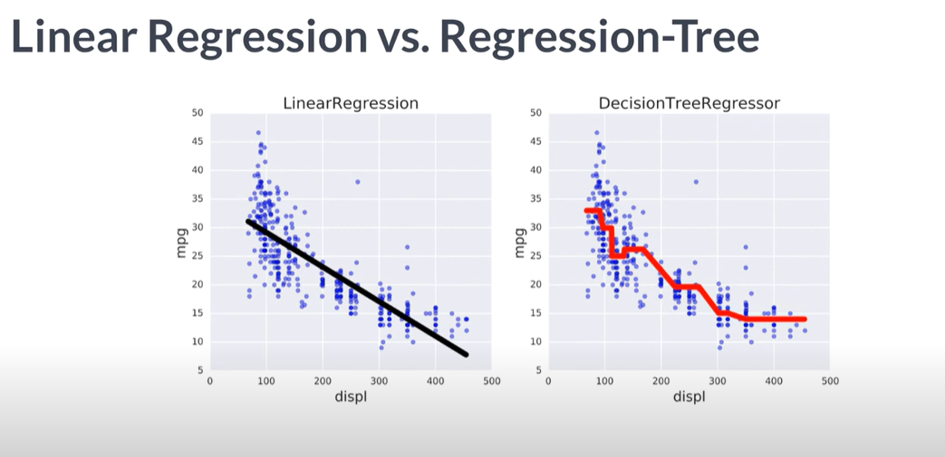
The underlying model is simply the average of the data points. For the initial root mode is what if we just predicted the average of the dependent variable of all our training data points. Another possible option would be instead of using the average to use median or we can even run a linear regression model. There are a lot of things we could do but in practice the average works really well.They do exist random forests models where the leaf nodes are independent linear regressions but they're not widely used.

Slide 7
THANK YOU

